Slide 1


Koppeling Isabel Connect
koppel rechtstreeks en automatisch met je bank

Slide 2
Isabel 6 en Isabel Connect
Inrichting in Profit
#hoedan

Slide 3
Isabel 6
Isabel Connect
Angelo van der Linden
Sales Campaign Manager

Slide 4

Isabel Group Mission Statement
“We enable SME and corporates
to grow their business
without hassle.”

Slide 5










Isabel Group at a glance
Partner ecosystem
Multibanking
Corporate Identity
E-Docs
Connectivity
Collaboration

Slide 6
In 1995, banks were swamped with paper
4 main banks created Isabel NV/SA

Slide 7


Goals
IBS4
Offer Business Clients a platform to:
  Consult Account Balances
  See Transaction Details
  Enter payments
  Upload payment files
  Sign payments
  Download account information
IBS5

Slide 8
Goals
2019
Offer Business Clients a platform to:
  Consult Account Balances
  See Transaction Details
  Enter payments
  Upload payment files
  Sign payments
  Download account information
Banks: 26
Subscriptions: 26.000+
Users: 70.000+

Slide 9


COLLABORATE
CONSOLIDATE
Company X Isabel Subscription
Account 1
Account 2
Bank A
Account 3
Enter transactions
Supplier accounting
Account 4
Bank B
Verify accounts
payment status
Customer accounting
Account 5
Bank C
Account 6
Sign Transactions
One or multiple signers
CFO/CEO
Account 7
Bank D

Slide 10
INTEGRATE
Manual
Uploads / Downloads
Payment Files
SEPA Credit Transfer
SEPA Direct Debits
Non-SEPA
Reporting Files
CODA
CAMT
MT940
Only 36%
Work integrated
Banks
ERP
ACCOUNTING SOFTWARE
Serious gain in time and efficiency
Decrease errors
Market starts to move

Slide 11

Isabel 6: Payment Solution for business users
01
SINGLE BANK INTERFACE
02
MULTIPLE USERS AND ROLES
03
INTEGRATION WITH ACCOUNTING SOFTWARE
04
TOP NOTCH SECURITY
05
SCALES WITH BUSINESS

Slide 12
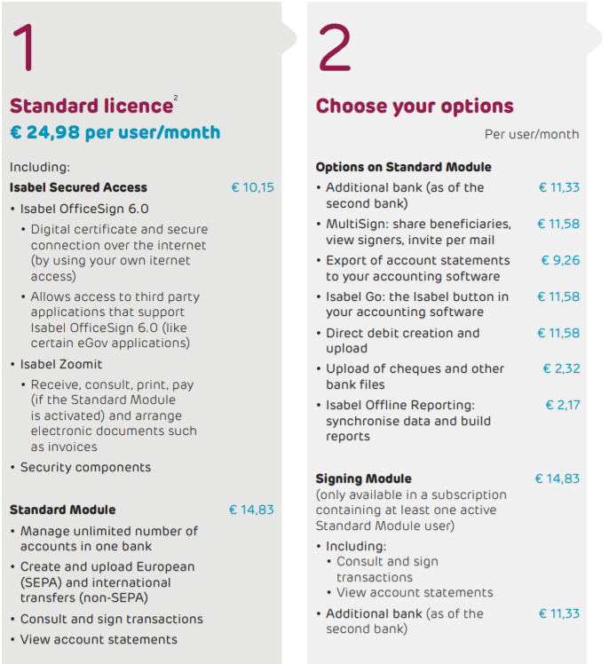
Modular Pricing
Example
1 Company - 1 User - 2 Banks - 7 Accounts
Export Account statements (CODA/CAMT)
1 user 1 x 24,98 EUR
1 extra bank 1 x 11,33 EUR
Export Account statements 1 x 9,26 EUR
Total 45,57 EUR

Slide 13
INTEGRATION - ISSUES
Manual Uploads / Downloads
Payment Files
SEPA Credit Transfer
SEPA Direct Debits
Non-SEPA
Reporting Files
CODA
CAMT
MT940
Banks
ERP
Accounting Software

Slide 14
INTEGRATION - ISSUES
Manual Uploads / Downloads
Compliance
Errors
Continuity
The possibility of forgetting or doubly uploading files
What if employees are away on holiday or sick? Is continuity ensured?
Physical access to payment files opens the way for fraud

Slide 15
INTEGRATION WITH ISABEL CONNECT
AFAS PROFIT
Banks
AFAS Profit accesses the
Isabel 6 platform on behalf of the user.

Slide 16


Isabel Connect – Functions
Sign Payments
Download Statement Files
AFAS
PROFIT
ISABEL 6
Upload Payment Files
SEPA Direct Debet

Slide 17
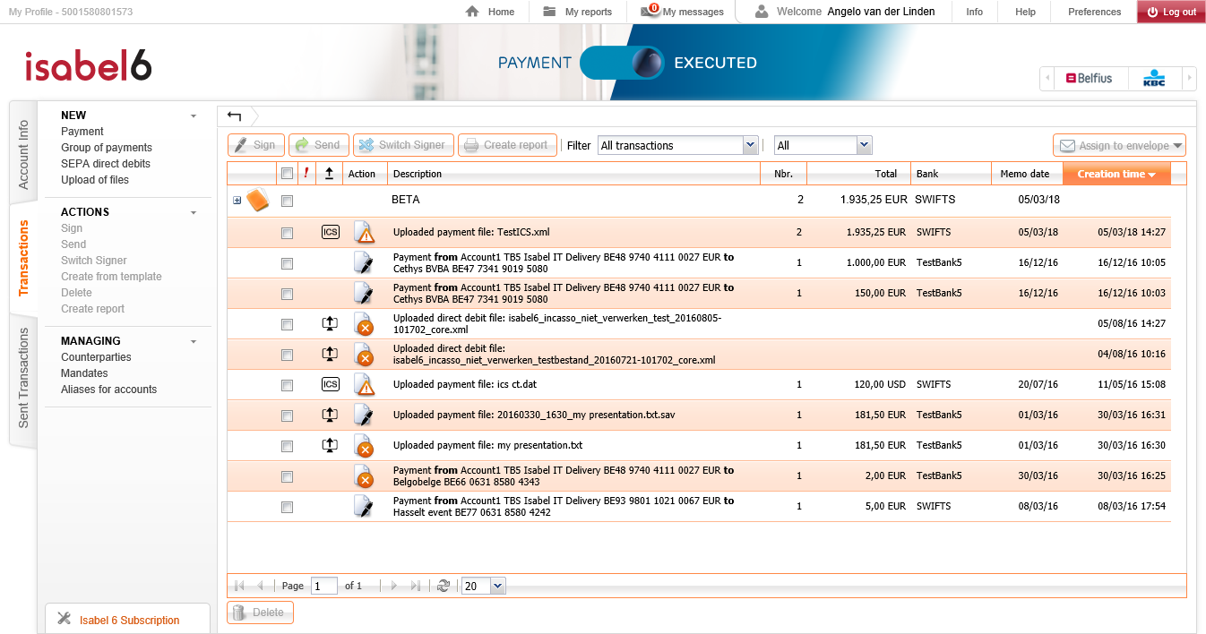

Transaction Area

Slide 18
Advantages
Convenience
You will be handle most of your financial transactions directly from within AFAS Profit, your known and preferred interface. Only signing transactions is handled from the Isabel 6 interface
Efficiency
An improved user experience, leading to time gain (e.g. CODA’s are downloaded before the accountant comes in the office).
Compliance
Unattended and automated file exchange: may be requirement from an audit point of view.

Slide 19
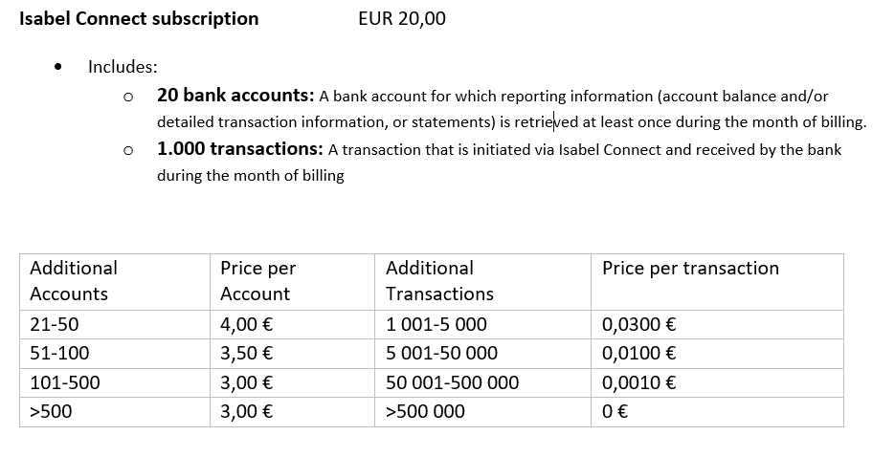
Pricing

Slide 20




Koppeling Isabel Connect
Isabel 6
Isabel Connect
Profit

Slide 21
Koppeling Isabel Connect
Communicatie
profiel
Isabel Connect
Profit

Slide 22
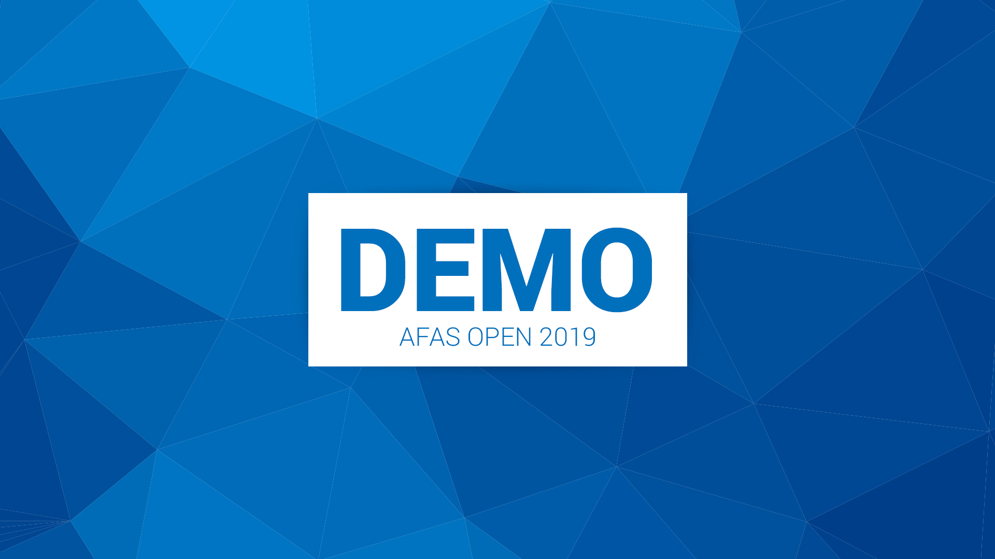
KOPPELING ISABEL CONNECT

Slide 23
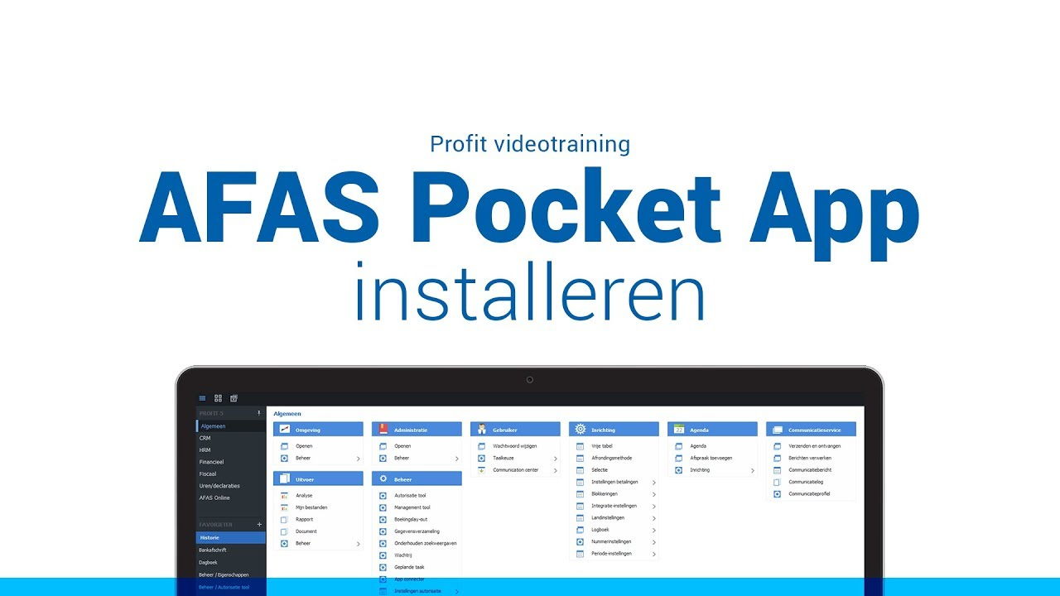
Profit help
AFAS Koppeling Isabel
Let op: CAMT53, per rekening

Slide 24

Uitleverbeleid
JUNI 2020
PROFIT 15
OKTOBER 2019
PROFIT 12
DECEMBER 2019
PROFIT 14
11 JUNI 2020
AFAS OPEN
OKTOBER 2020
PROFIT 16

Slide 25

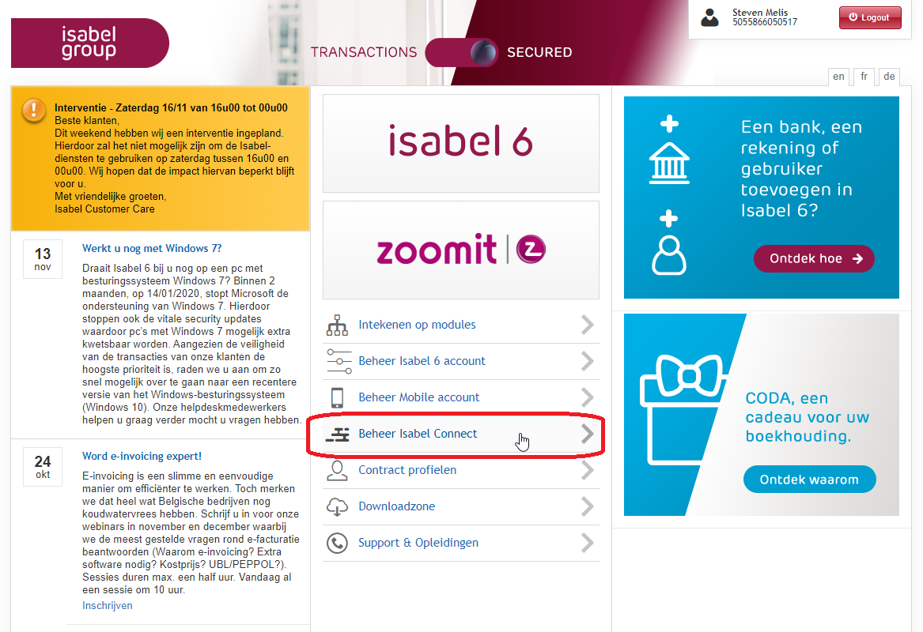

Slide 26
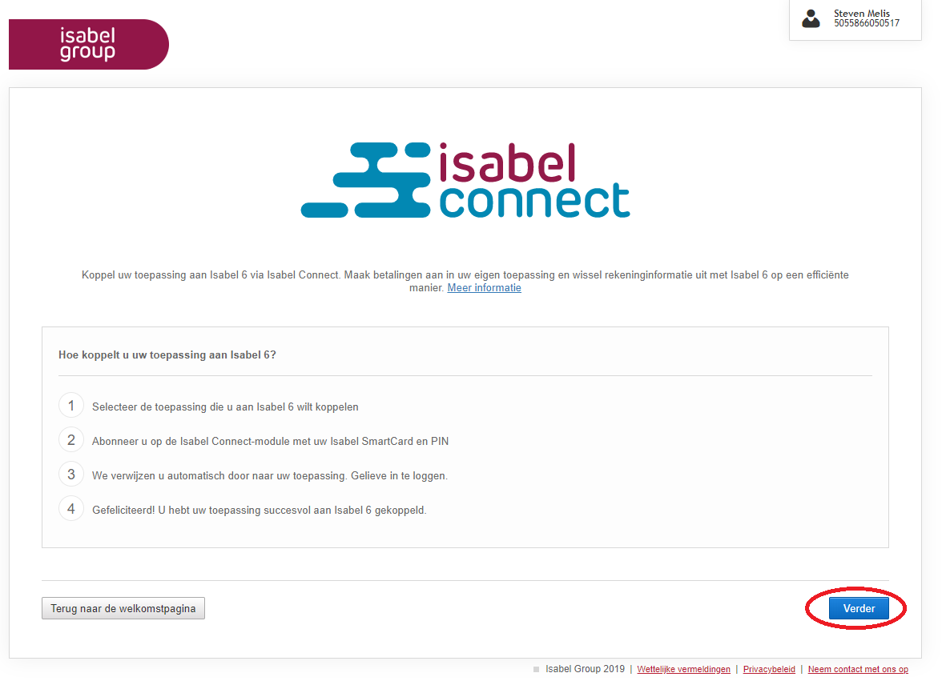

Slide 27
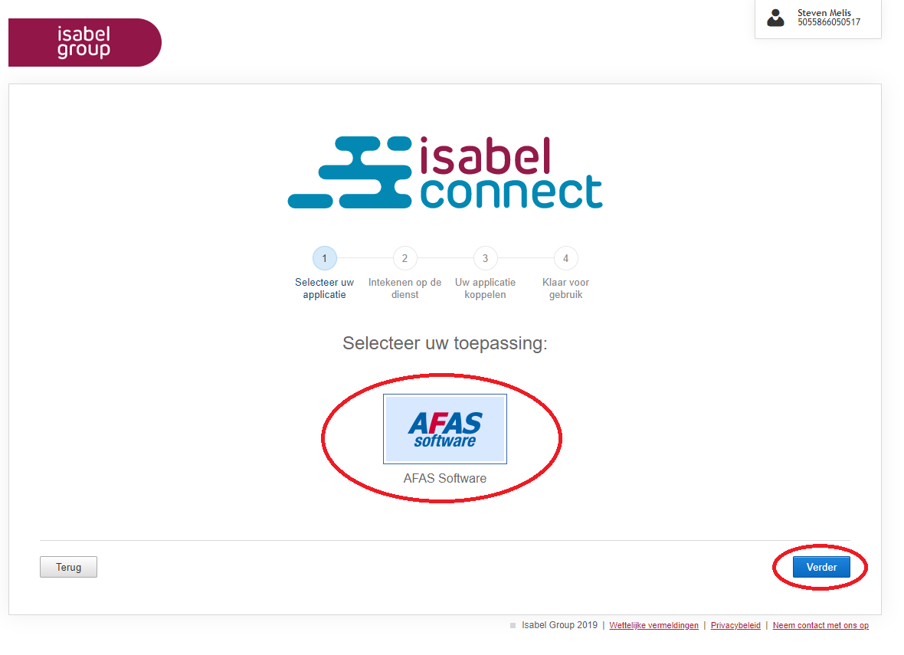

Slide 28
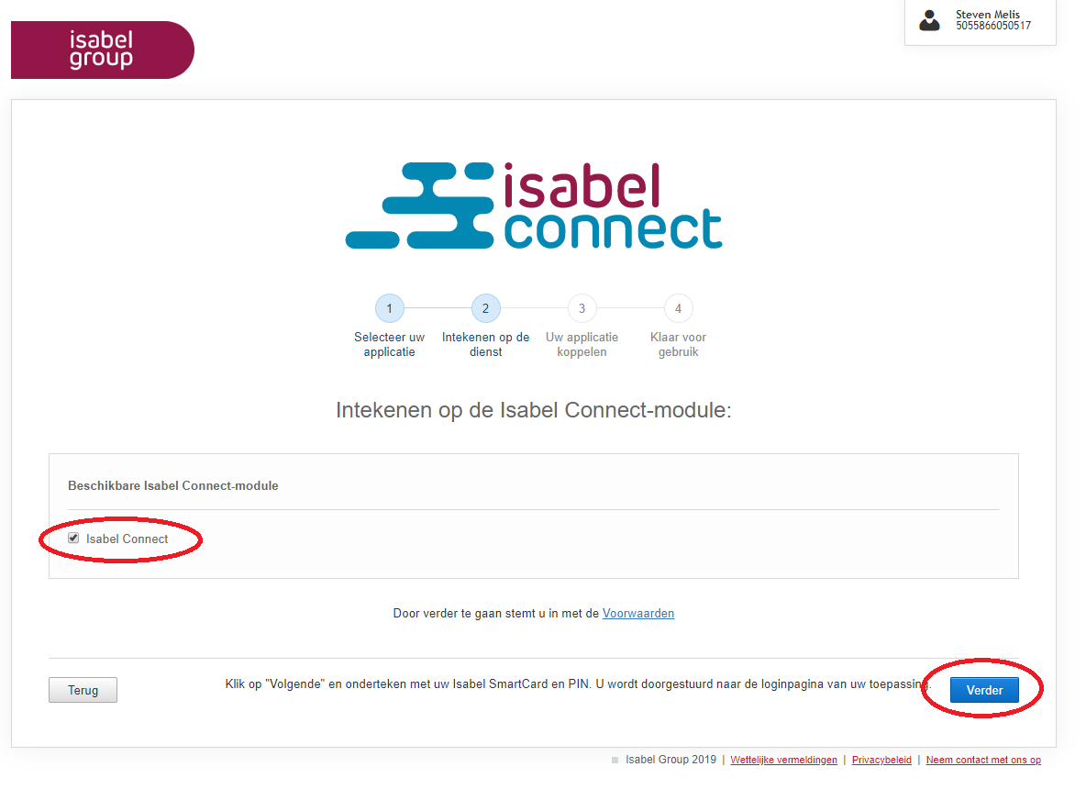

Slide 29
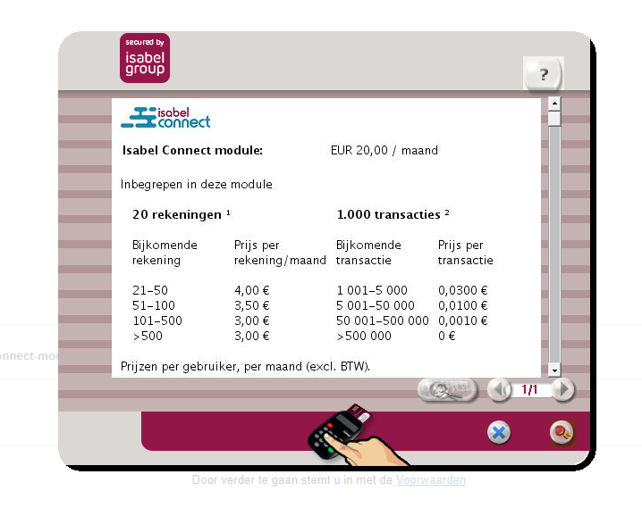

Slide 30
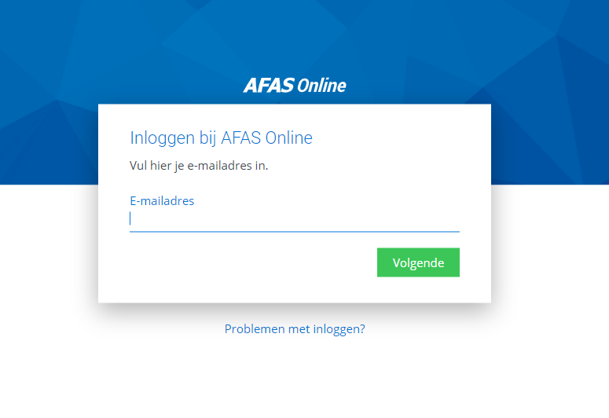

Slide 31
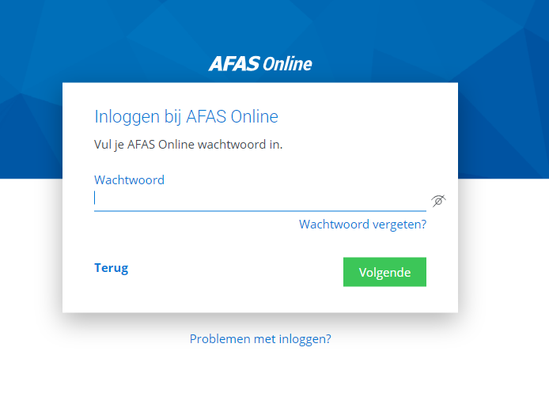

Slide 32
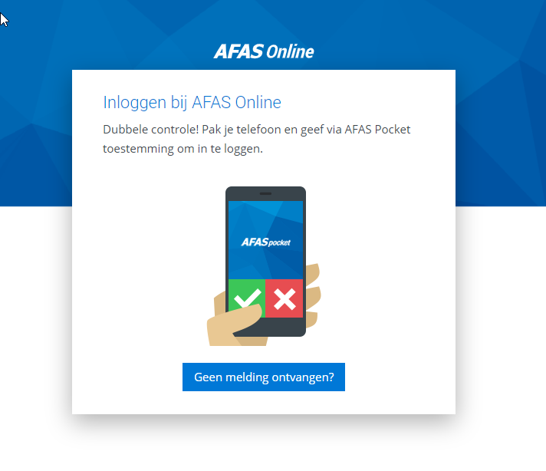

Slide 33
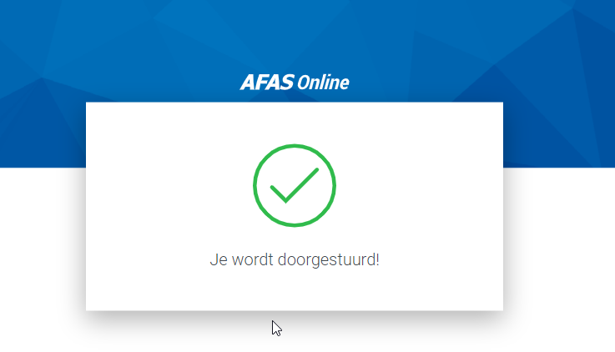

Slide 34
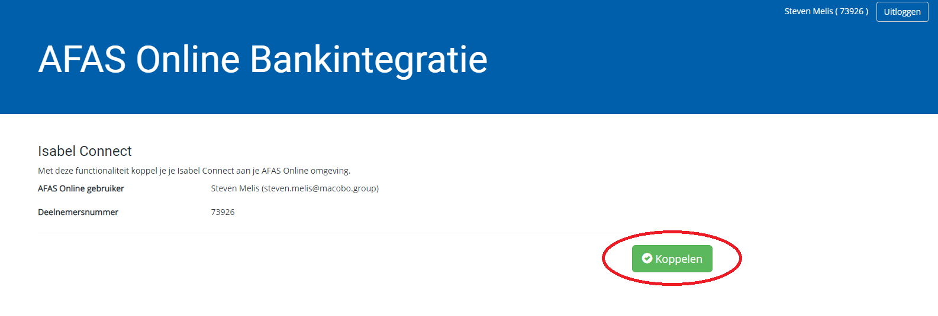

Slide 35
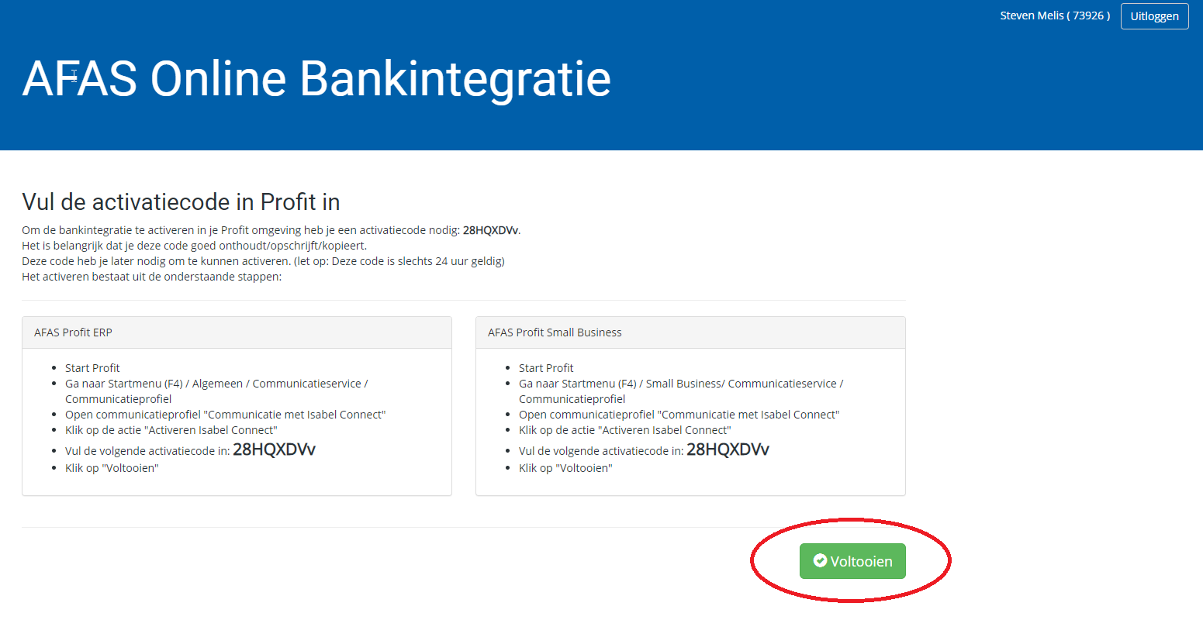

Slide 36
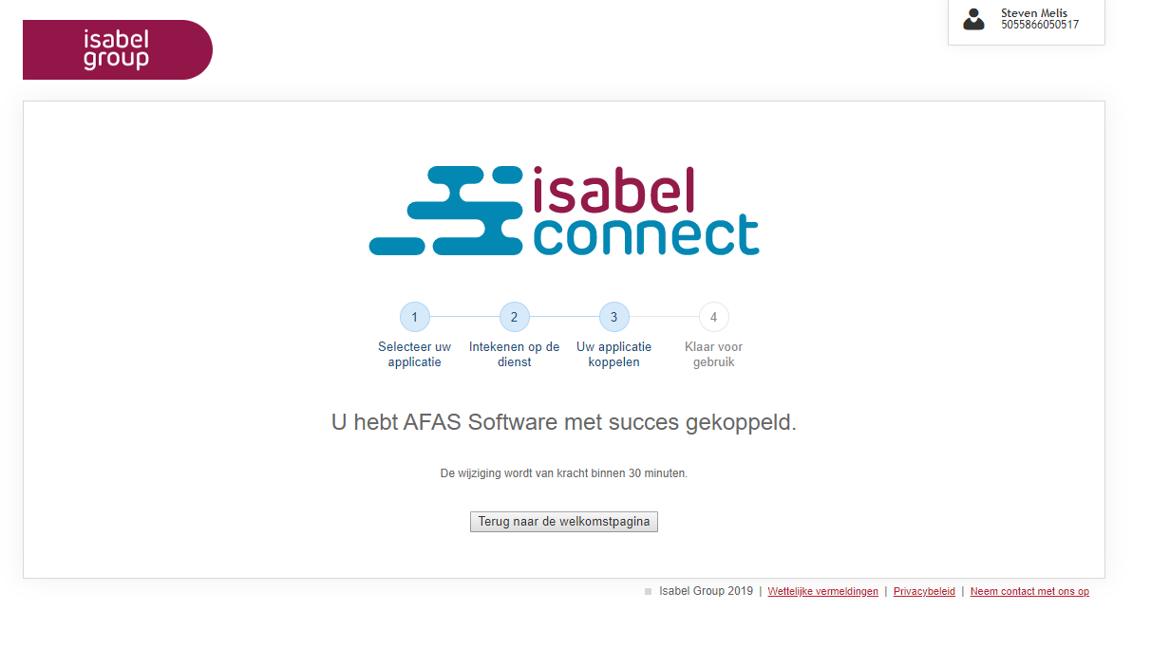

Slide 37
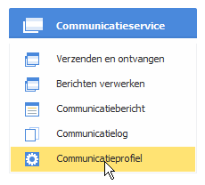

Slide 38
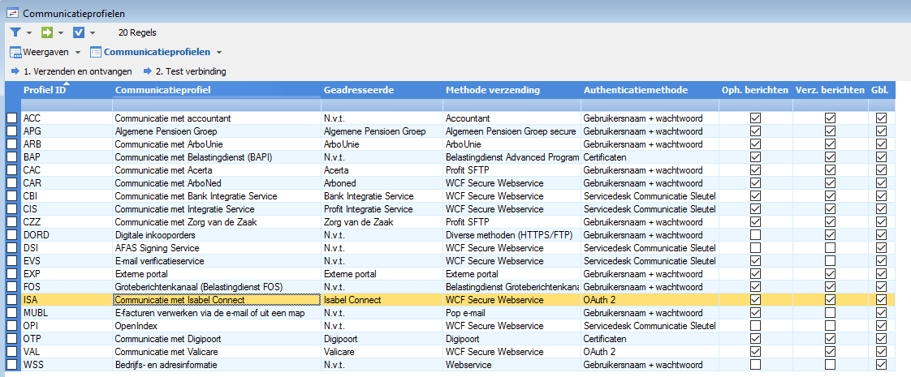

Slide 39
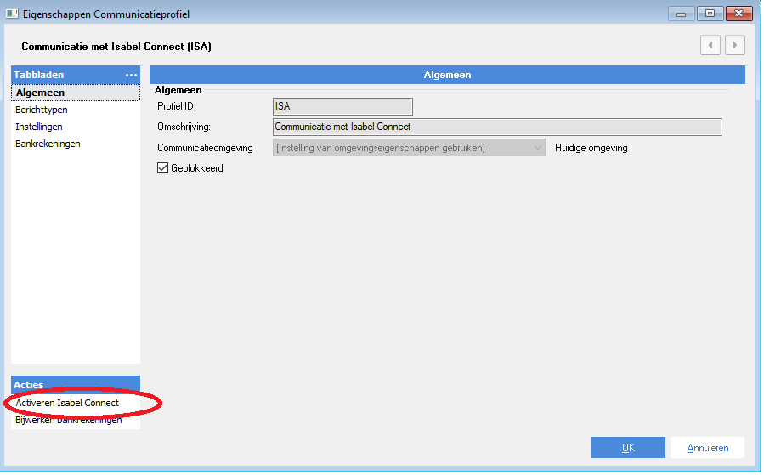
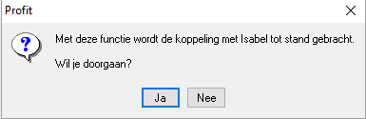

Slide 40
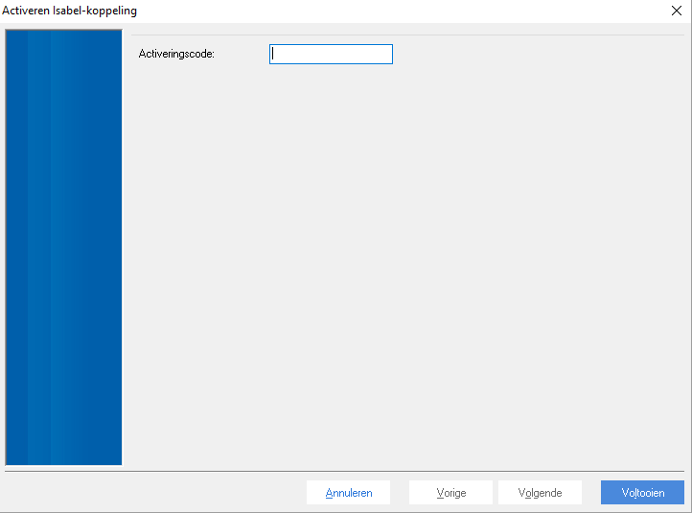

Slide 41
VRAGEN

